Slide 1
Nexthikes IT Solutions
PROJECT-8
Job Market Analysis
&
Recommendation System
Mr. Abish Chaurasia
08th November 2025

Slide 2
Agenda
Objective
Define the purpose of analyzing job market data and building a recommendation system.
Situational Overview
Highlight the current challenges and opportunities in the job market.
Project Tasks & Deliverables
Break down the project into tasks: analysis, prediction, and recommendation engine.
Technology & Tools
List data sources, ML libraries, visualization tools, and deployment technologies.
Incorporating Docker
Explain how Docker ensures portability, consistency, and easy deployment.
Results & Insights
Present key findings, dashboards, and recommendations generated by the model.

Slide 3
Objective
Primary Objective:
Analyze job market trends and build a recommendation system for job seekers.
Identify high-demand job roles, salary trends, and emerging job categories.
Provide personalized job recommendations using real-time data.
Outcome:
Empower job seekers and recruiters to make data-driven career decisions.

Slide 4
Situational Overview
Need for actionable insights:
Understand market changes
Identify opportunities faster
Adapt skillsets to meet demand
The job market is dynamic, influenced by:
Technological advancements
Economic shifts
Cultural trends
Approach:
Use data analytics + machine learning models to uncover trends
Provide data-driven job recommendations

Slide 5
Project Architecture & Methodology
Data Sources: Mention that the data will be accessed from specified sources.
Technology & Tools: List the core technologies:
Analytics: Python, Pandas, Scikit-Learn, TensorFlow.
Visualization: Matplotlib, Seaborn, Plotly.
Web: Flask or Django.
Containerization: Docker.
Methodology: Briefly describe the approach (Data Analysis -> Predictive Modeling -> Recommendation Engine).

Slide 6
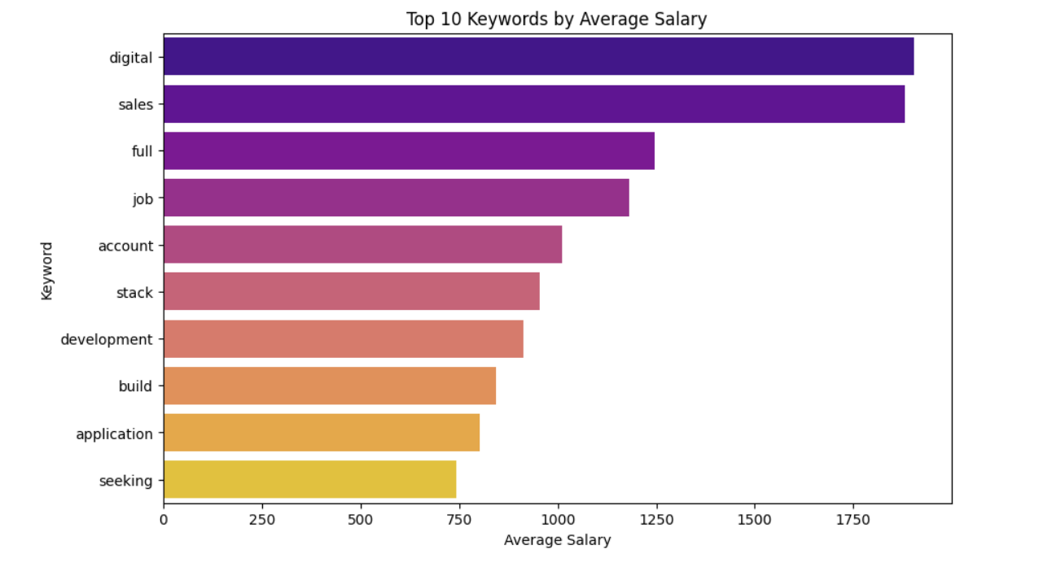
Top 10 Keywords by Average Salary

Slide 7
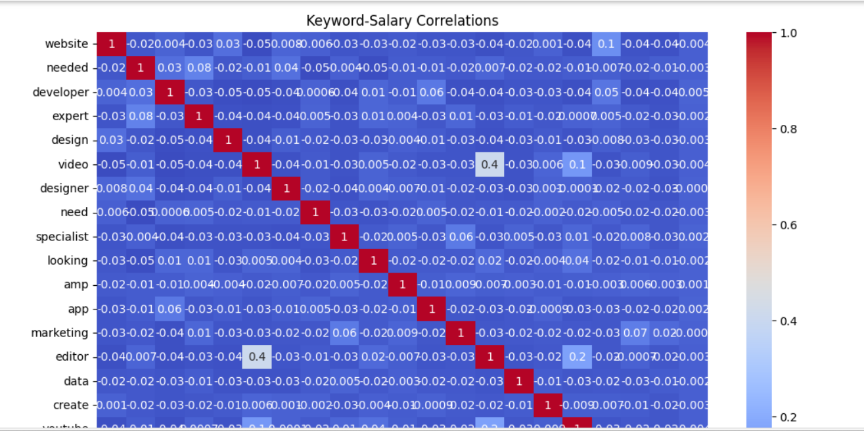
Correlation Analysis

Slide 8
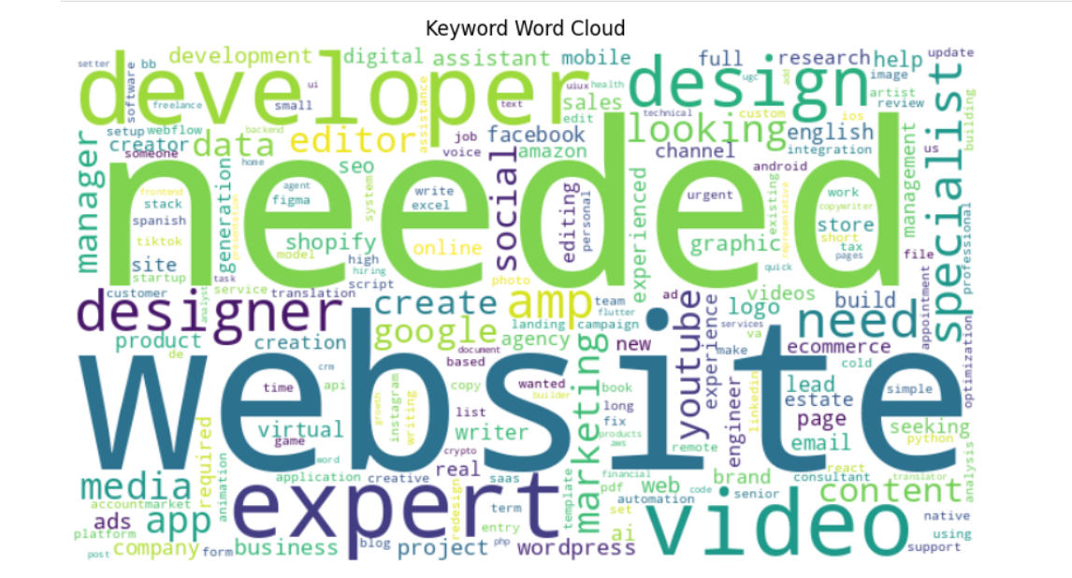
Word Cloud Visualization

Slide 9
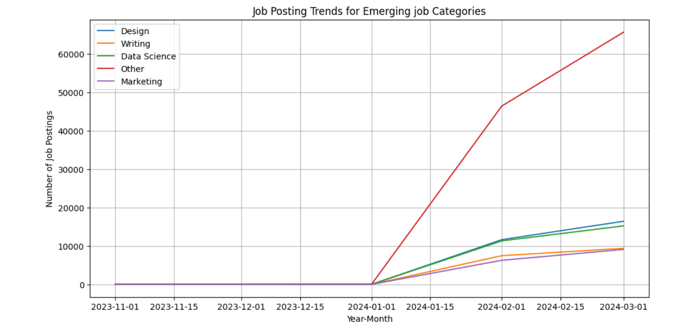
Job Posting Trends for Emerging Job Categories

Slide 10
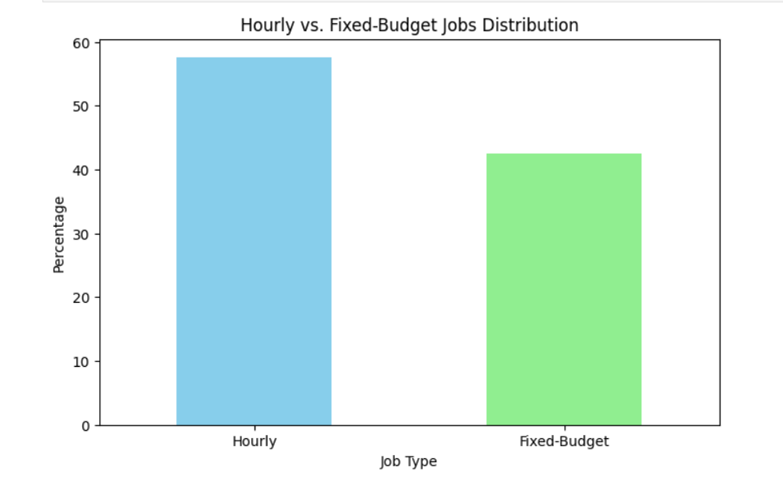
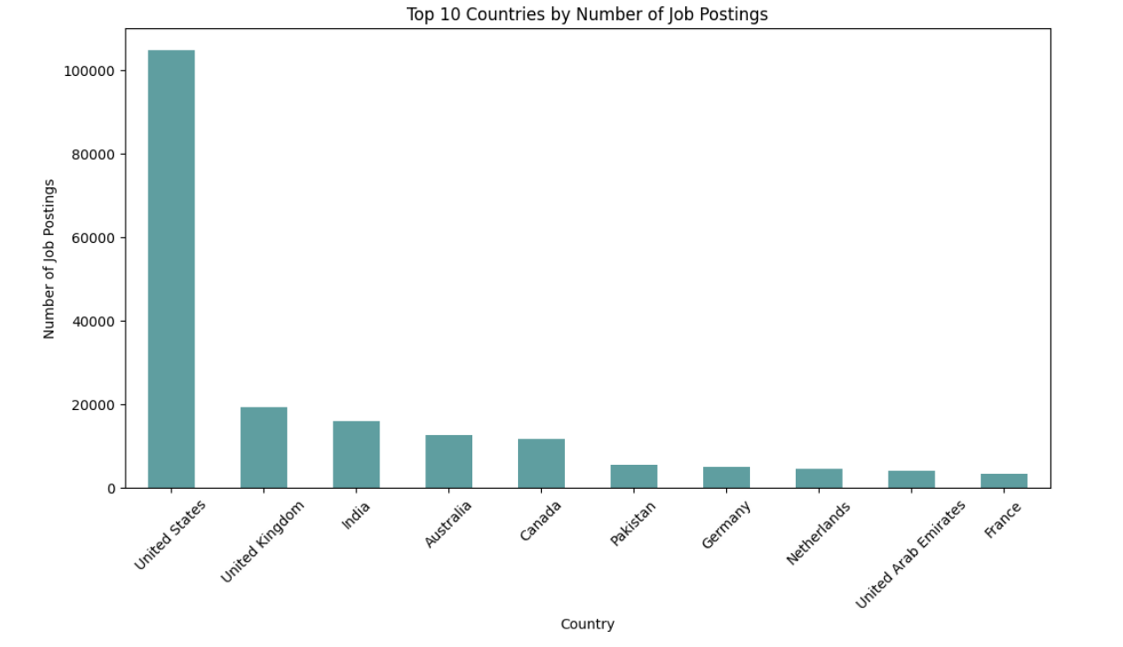
Job Type Distribution
Visualization: A pie chart or a bar chart is perfect for this. A pie chart shows the proportion of Hourly versus Fixed-Price jobs, while a bar chart can show the absolute counts of each.
Insight: This visualization clarifies which payment model is more common on Upwork, a critical piece of information for both freelancers and clients.

Slide 11
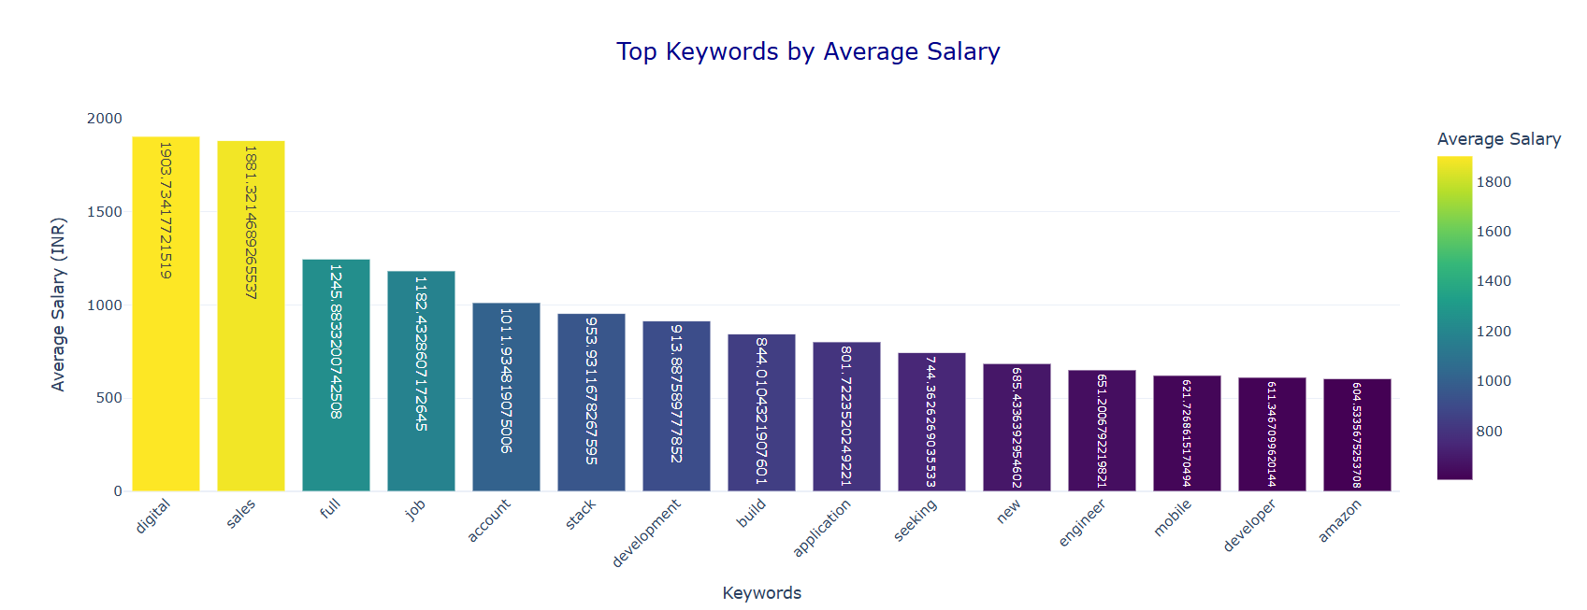
Top Keywords by Average Salary

Slide 12
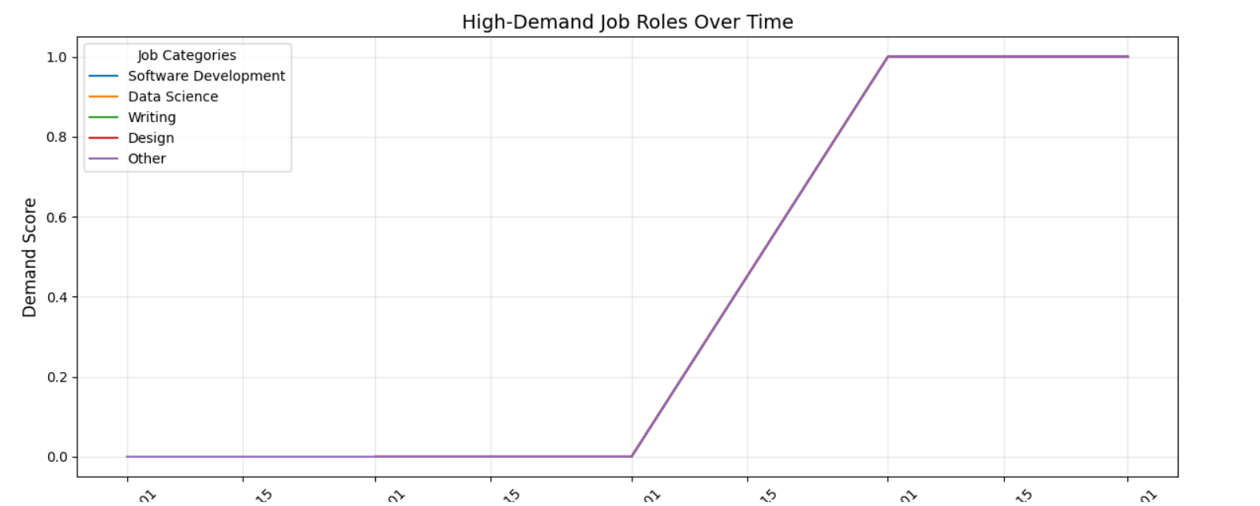
High-Demand Job Roles

Slide 13
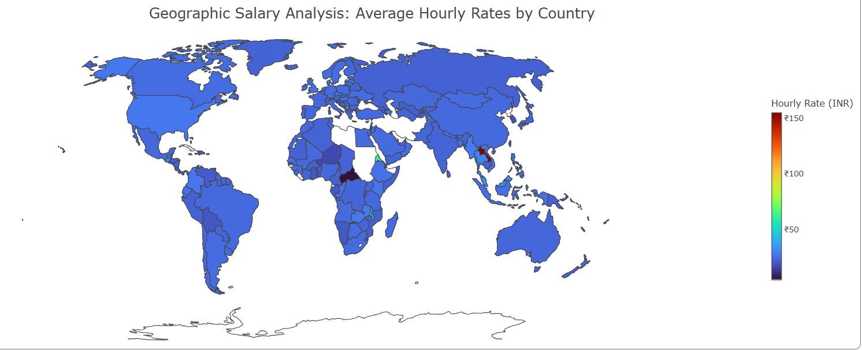
Geographic Salary Analysis

Slide 14
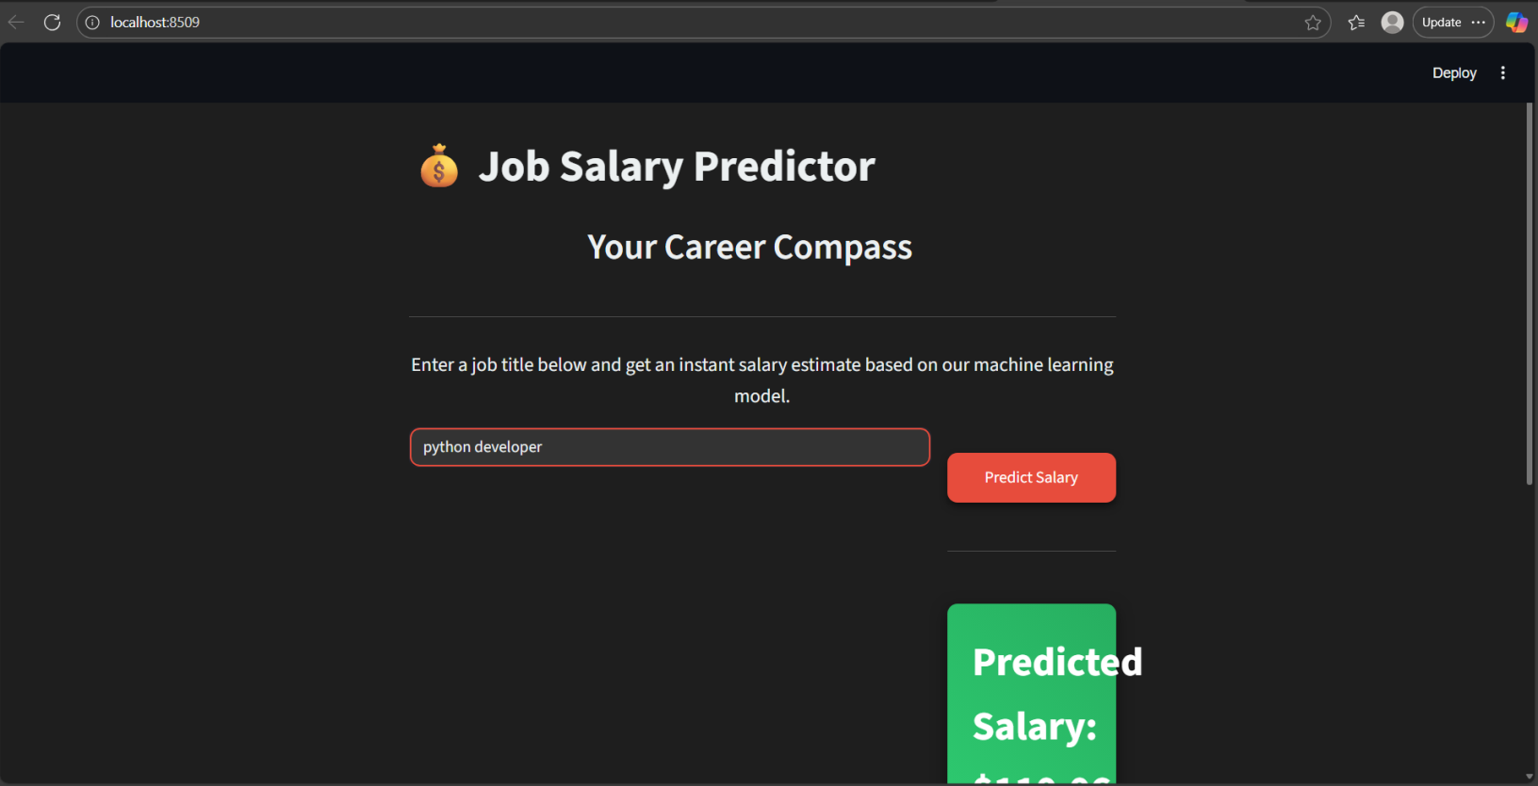
The Recommendation Engine & Deployment
Objective: To develop a personalized job recommendation engine based on the analysis.
Functionality: Explain how the engine would work (e.g., matching user profiles to job keywords and salary data).
Deployment: Briefly touch on the use of Docker and Streamlit to package and deploy the model for a user-friendly experience.

Slide 15
Conclusion & Key Findings
Summary: Briefly recap the most important findings from the analysis.
The top skills and niches on the platform.
The most profitable keywords.
The most prevalent job types and geographical locations.
Overall Project Takeaway: Summarize what the analysis reveals about the current state of the Upwork freelance market and the project's value.

Slide 16
References
Python: https://www.python.org/
Pandas: https://pandas.pydata.org/docs/
Scikit-Learn: https://scikit-learn.org/stable/
Kaggle: https://www.kaggle.com/
Hugging Face: https://huggingface.co/
Thank you

